Slide 1
We will get started shortly.

Slide 2
Dr. Tina Božičnik

Slide 3
Medical Disclaimer:
The information provided is for educational purposes and is not intended as medical advice, or a substitute for the medical advice of a physician or other qualified health care professional. This is for science and educational purposes only and cannot be used in any aspect for sales or marketing. You should not use this information for diagnosing a health or fitness problem or disease. You should always consult with a doctor or other health care professional for medical advice or information about diagnosis and treatment. This is Confidential. Do not distribute—for scientific educational purposes only.
Notes:
The information provided is for educational purposes and is not intended as medical advice, or a substitute for the medical advice of a physician or other qualified health care professional. This is for science and educational purposes only and cannot be used in any aspect for sales or marketing. You should not use this information for diagnosing a health or fitness problem or disease. You should always consult with a doctor or other health care professional for medical advice or information about diagnosis and treatment. This is Confidential. Do not distribute—for scientific educational purposes only.

Slide 4
ISNS Case Study Presented by: Dr. Tina Božičnik
International Science Nutrition Society- CURARE CAUSAM 2023

Slide 5
ISNS CASE STUDY: PEDIATRIC ALOPECIA

Slide 6
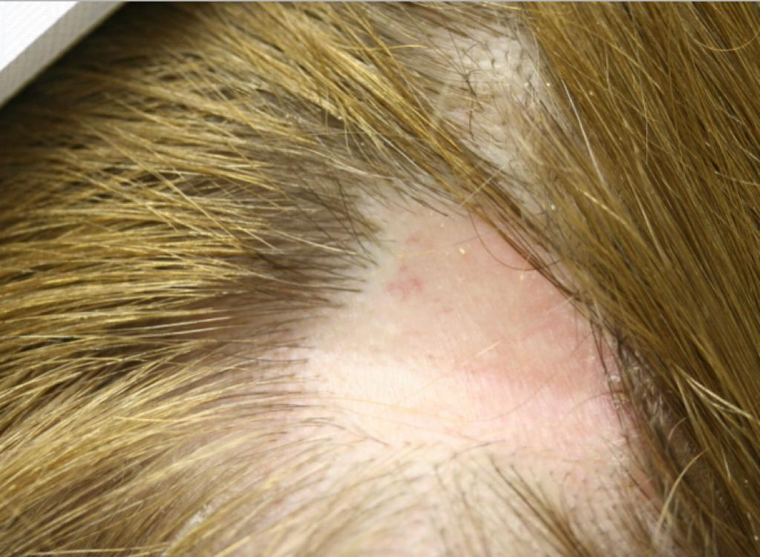
What is Alopecia?
Alopecia areata is a disease that occurs when the immune system attacks hair follicles and causes hair loss. Hair follicles are the structures in skin that form hair. While hair can be lost from any part of the body, alopecia areata usually affects the head and face. Hair typically falls out in small, round patches about the size of a quarter, but in some cases, hair loss is more extensive. Most people with the disease are healthy and have no other symptoms.
The course of alopecia areata varies from person to person. Some have bouts of hair loss throughout their lives, while others only have one episode. Recovery is unpredictable too, with hair regrowing fully in some people but not others.
There is no cure for alopecia areata, but there are treatments that help hair grow back more quickly.
https://www.ncbi.nlm.nih.gov/books/NBK563225/?report=reader#!po=1.38889
International Science Nutrition Society- CURARE CAUSAM 2023

Slide 7
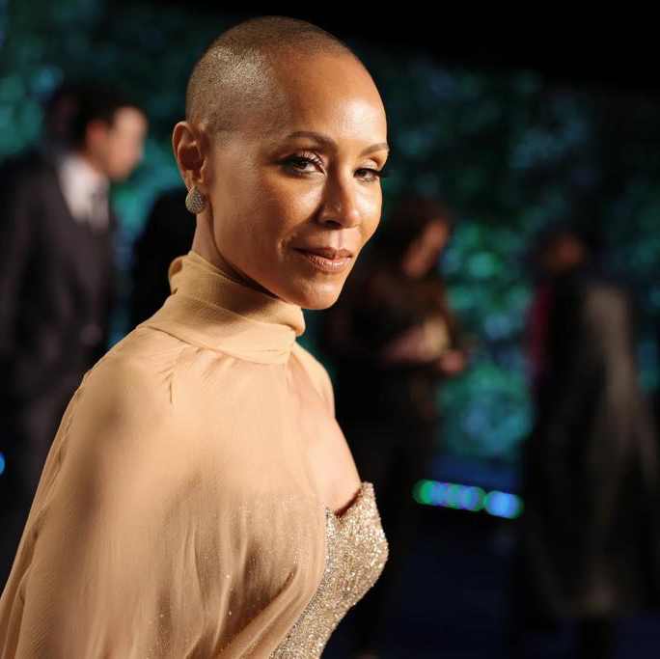
Who gets Alopecia Areata?
Anyone can develop alopecia areata. Men and women get it equally, and it affects all racial and ethnic groups. The onset an be at any age, but most people get it in their teens, twenties, or thirties.
When it occurs in children under the age of 10, it tends to be more extensive and progressive.
If you have a close family member with the disease, you may have a higher risk of getting it, but for man people, there is no family history.
Scientists have linked several genes to the disease, which suggests that genetics play a role in alopecia areata. Many genes they have found are important for the functioning of the immune system.
People with certain autoimmune diseases, such as psoriasis, thyroid disease, or vitiligo, are more likely to get alopecia areata, as are those with allergic conditions such as hay fever.
The most common causes 90-95% are caused by: Alopecia areata- autoimmune .Attack to the hair follicles Loss of patches of hair can progress to alopecia totalis , which is determined as hair loss on the entire scalp
International Science Nutrition Society- CURARE CAUSAM 2023

Slide 8
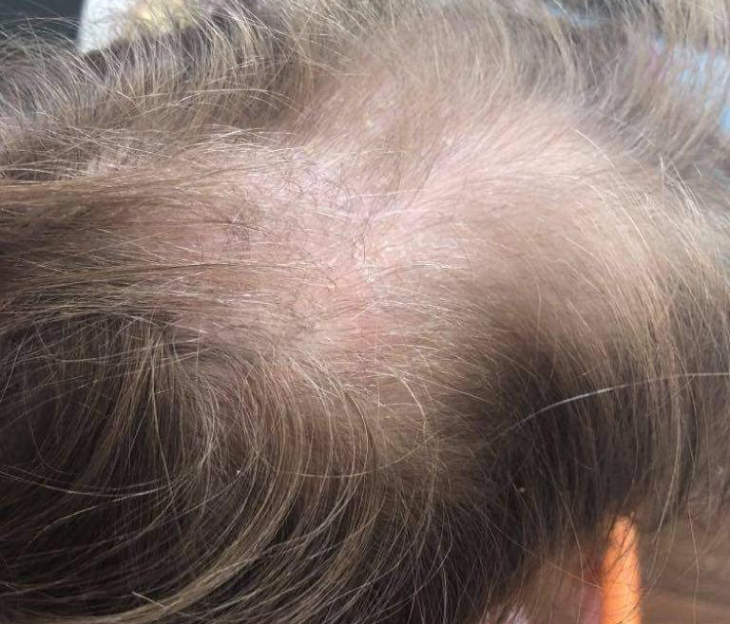
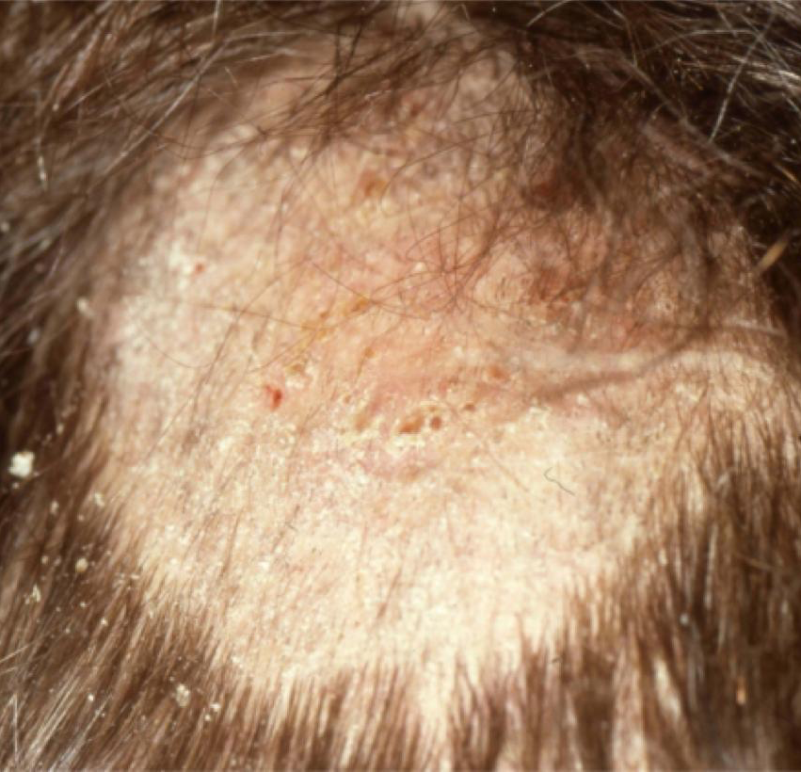
Types of Alopecia Areata
There are different types of this condition. Alopecia areata is the most common in its main form, but there are other, more rare types:
Patchy alopecia areata – In this type, which is the most common, hair loss happens in one or more coin-sized patches on the scalp or other parts of the body .
Alopecia totalis- People with this type lose all or nearly all the hair on their scalp.
Alopecia universalis- In this type, which is rare, there is a complete or nearly complete loss of hair on the scalp, face, and rest of the body.
Diffuse alopecia areata – Is a sudden thinning of the hair rather than lost patches.
Ophiasis alopecia areata- Causes hair loss in a band shape around the sides and back of the head.
Telogen effluvium: Telogen effluvium is a form of temporary hair loss that usually happens after stress, a shock, or a traumatic event. It usually occurs on the top of the scalp
Tinea capitis (TC) is a common dermatophyte infection affecting primarily prepubertal children. The causative pathogens belong to only two genera: Trichophyton and Microsporum.
https://www.researchgate.net/figure/Tinea-capitis-endotrix_fig1_50851399
International Science Nutrition Society- CURARE CAUSAM 2023

Slide 9
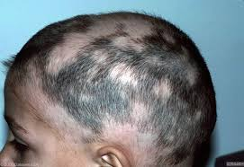
Patchy Alopecia Areata
In this type, hair loss occurs suddenly and usually starts with one or more circular bald patches that may overlap.
The hair loss can be the result of heredity, hormonal changes, medical conditions, or a normal part of aging.
International Science Nutrition Society- CURARE CAUSAM- 2023

Slide 10
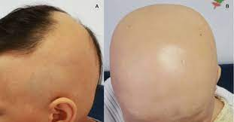
Alopecia totalis
Alopecia totalis is a skin condition that causes hair loss. It is not the same as localized alopecia areata.
Alopecia totalis is the complete loss of all hair on the head. This type can begin as alopecia areata and may start off with small patches of hair loss. These patches spread over time until the entire head is bald.
Hair loss can begin suddenly and occur rapidly. If you have alopecia totalis, you may also have brittle, pitted nails.
International Science Nutrition Society- CURARE CAUSAM- 2023

Slide 11
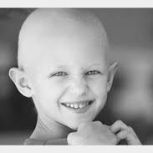
Alopecia universalis
Alopecia universalis (AU) is a condition characterized by the complete loss of hair on the scalp and body. It is an advanced form of alopecia areata, a condition that causes round patches of hair loss.
It is the most severe form of alopecia areata.
Causes hair loss in a band shape around the sides and back of the head.
International Science Nutrition Society- CURARE CAUSAM- 2023

Slide 12
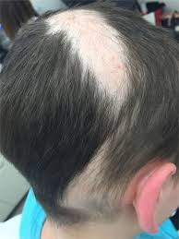
Alopecia Areata in Children
Alopecia areata occurs when the immune system mistakenly attacks the tissues that grow hair (follicles). This condition is not contagious, and children of any age can get alopecia areata.
Children lose between 50 and 100 strands of hair everyday. Normally, new strands start growing from the same hair follicle.
When children have alopecia areata, their immune system mistakenly sees hair follicles as a threat and attacks them. This causes their hair to fall out.
International Science Nutrition Society- CURARE CAUSAM- 2023

Slide 13
Clinical, Cosmetic and Investigational Dermatology
Trichotillomania - hair pulling disorder
Trichotillomania, a mental disorder that involves recurrent, irresistible urges to pull out hair from your scalp, eyebrows or other areas of your body, despite trying to stop.
Rarer reasons for alopecia in children include pressure-induced alopecia, alopecia related to nutritional deficiency or toxic ingestion, toxicity and androgenetic alopecia. Congenital lesions should be considered for areas of localized alopecia occurring at birth. Some cases of alopecia areata were reported in neonatal period - autoimmune cause suspected
Androgenic alopecia - often under-recognized in children - hormone disbalance- DHT (dihydrotestosterone in particular) attacks hair follicles and causes them to fall out and stop growing.
International Science Nutrition Society- CURARE CAUSAM- 2023

Slide 14
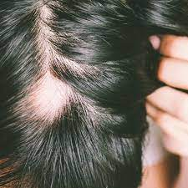
Symptoms of Alopecia
Alopecia areata primarily affects hair, but in some cases, there are nail changes as well. People with the disease are usually healthy and have no other symptoms.
Alopecia usually begins with sudden hair loss of round or oval patches of hair on the scalp, but any part of the body can be affected, such as the beard area in men, or the eyebrows or eyelashes.
Around the edges of the patch, there are often short broken hairs or “exclamation point” hairs that are narrower at their base than their tip. There is usually no sign of rash, redness, or scarring on the bare patches. Some people say they feel tingling, burning, or itching on the patches of skin right before the hair falls out.
International Science Nutrition Society- CURARE CAUSAM- 2023

Slide 15
Symptoms Continued
When a bare patch develops, it is hard to predict what will happen next. The possibilities include:
The hair regrows within a few months. It may look white or gray at first but may regain its natural color over time.
Additional bare patches develop. Sometimes hair regrows in the first patch while new bare patches form.
Small patches join to form larger ones. In rare cases, hair is eventually lost from the entire scalp, called alopecia totalis.
There is a progression to complete loss of body hair, a type of the disease called alopecia universalis, which is rare.
In most cases, the hair regrows, but there may be subsequent episodes of hair loss.
The hair tends to regrow on its own more fully in people with:
Less extensive hair loss
Later age of onset
No nail changes
No family history of the disease
Nail Changes
- Nail changes such as ridges and pits occur in some people, especially those who have more extensive hair loss.
International Science Nutrition Society- CURARE CAUSAM- 2023

Slide 16
Diagnosis
If you think your child has alopecia, you may want to see a dermatologist, which is a skin specialist.
They will:
Talk about the symptoms
Take a close look at the areas where they have hair loss
They may pull gently on the hairs at the edges of the bald patch to see if they come out easily
They may also check individual hairs and follicles to see if they are abnormally shaped
They will examine their nails
In rare cases, they may take a biopsy, which means a small piece of skin is removed from their scalp and looked at under a microscope.
Several conditions can cause hair loss. So, the doctor may test their skin for a fungal infection, or give them a blood test to check thyroid, hormone, or immune system problems.
International Science Nutrition Society- CURARE CAUSAM- 2023

Slide 17
Conventional Treatment
There is no cure for alopecia areata.
Your child’s hair may grow back on its own within a few months. It may take longer, depending on the extent of hair loss and whether they have lost hair more than once.
Recommended treatments include:
Scalp medications that encourage hair growth, such as corticosteroids or minoxidil.
Oral medications or injections to affect the immune system
Treatments often help the hair to grow back, but they do not always work. Unfortunately, alopecia areata is very unpredictable and differs from person to person. Even if the hair grows back, your child may have hair loss again in the same or new areas.
International Science Nutrition Society- CURARE CAUSAM- 2023

Slide 18
Nutritional Relevancies

Slide 19
Iron
Iron- acts through DNA synthesis action. Iron deficiency, prevents proper functioning of ribonucleotide reductase, a very important enzyme responsible for new cell production, like new hair follicles, causing hair growth problems. Lack of iron- iron is very important in protecting the cells from oxidative stress, can lead to build up of H2O2 - peroxide in the cells and cause their damage- causing inflammation caused alopecia.
Iron regulates hair growth genes.
Inflammation caused is also caused by toxicity that causes inflammation and uses body reserves of iron, zinc, fatty acids- natural anti-inflammatory agents. Toxins on other levels cause hormone disbalance and through that we have multiple causes driving alopecia. Toxins directly disrupt the gut lining causing leaky gut that in turn also by food related antibody production causes an immune hair follicle attack.
International Science Nutrition Society- CURARE CAUSAM- 2023

Slide 20
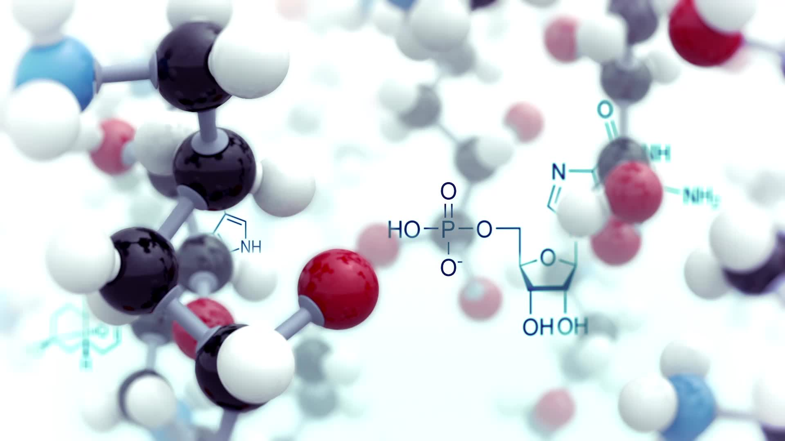
Zinc Deficiency
Zinc is a key element in immunity, protein synthesis and cell division and very important therefore in follicle growth. Without zinc hair regeneration and growth is impossible.

Slide 21
Biotin Deficiency (Vitamin H)
Very important for people on antiepileptic medication and frequent use of antibiotics can cause Biotin deficiency. Biotin plays a role in carboxylation processes in the body and through that enabling our cells have enough energy. Transforming nutrients into energy. You need biotin for radiant skin and beautiful hair.
Your hair can thin or stop growing, skin becomes dehydrated because sebaceous glands can’t work, nails can become very brittle with vertical ridges.
International Science Nutrition Society- CURARE CAUSAM- 2023

Slide 22
Vitamin D
Regulates Th1 and Th1 and Th2 autoimmune response (anti-autoimmune action) it also regulates the hormonal environment for proper hair growth and regeneration (works epigenetically in a sense)
International Science Nutrition Society- CURARE CAUSAM- 2023

Slide 23
Vitamin A
Works on hair follicle stem cells activation! Important here that OVER supplementation can cause hair loss and dramatic thinning.
International Science Nutrition Society- CURARE CAUSAM- 2023

Slide 24
PROPRIETARY BLENDS LEGEND
Proprietary blend I: Silica, Vitamin C, and Trace Minerals
Proprietary blend II: N-acetyl L-tyrosine, Anhydrous Caffeine, L-theanine, Velvet Bean Seed, Pine Bark, Curcumin, and Vitamin D
Proprietary blend III: Black seed oil, Resveratrol, turmeric, Raspberry Ketones, Apple Cider Vinegar, Aloe Vera, and D-Ribose
International Science Nutrition Society- CURARE CAUSAM- 2023

Slide 25
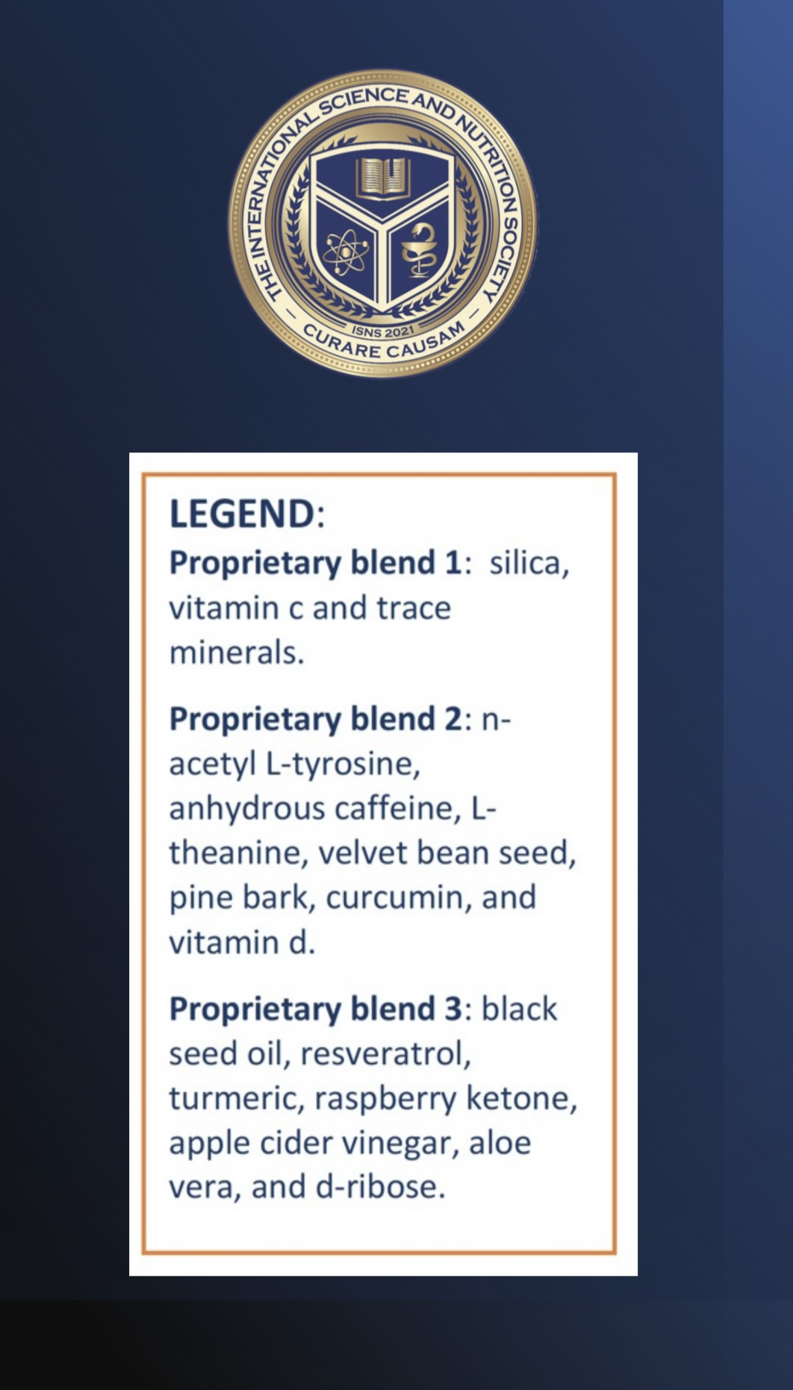
CASE STUDY
Patient: Male
Age: 4 years old
Background/Symptoms: 4-year-old boy presented with a case of alopecia areata that progressed almost to alopecia totalis. He was healthy before without any known allergies or problems. Mother reports that a few weeks after the vaccination his hair started falling out and progressed to almost the entire scalp very quicky. Conventional prescribed treatments were not working.
Treatment: As he came in integrative whole-body examination was done and personalized treatment with the proprietary blends started.
International Science Nutrition Society- CURARE CAUSAM- 2023

Slide 26
Before Starting Conventional Treatment

Slide 27
Progression After Conventional Treatment Started

Slide 28
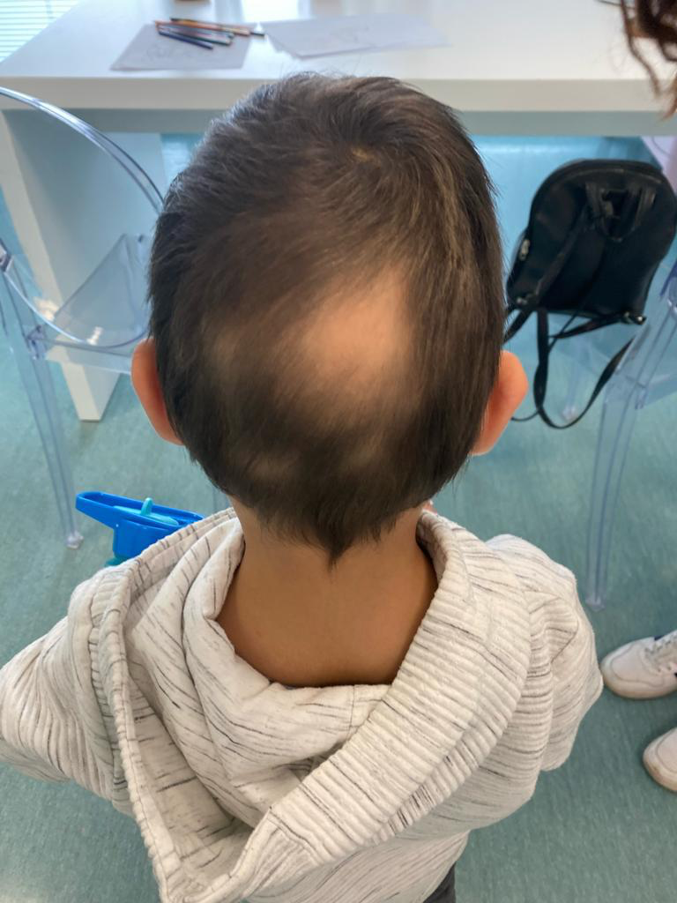
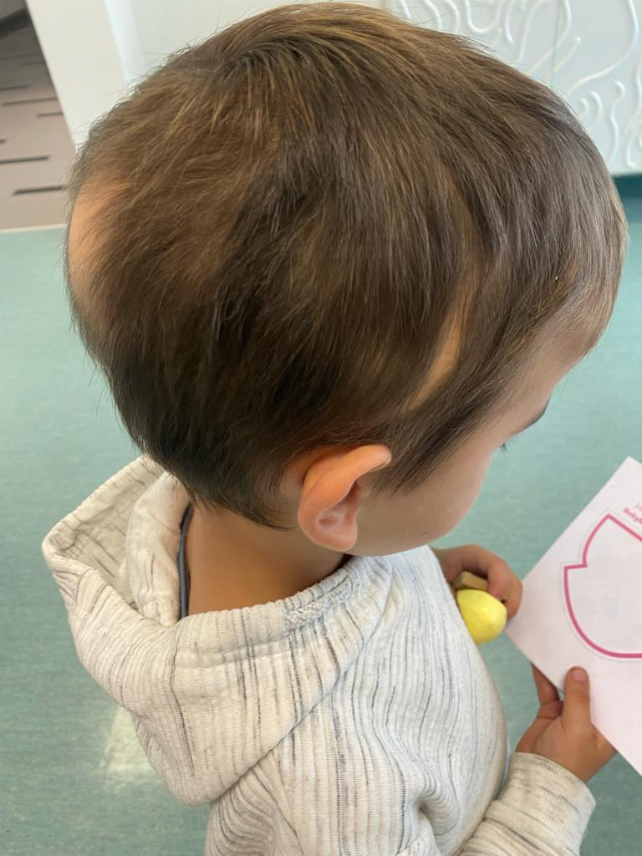
Progression After Administering 1 of 5 Proprietary Root Blends
Proprietary Blend No. I was administered

Slide 29
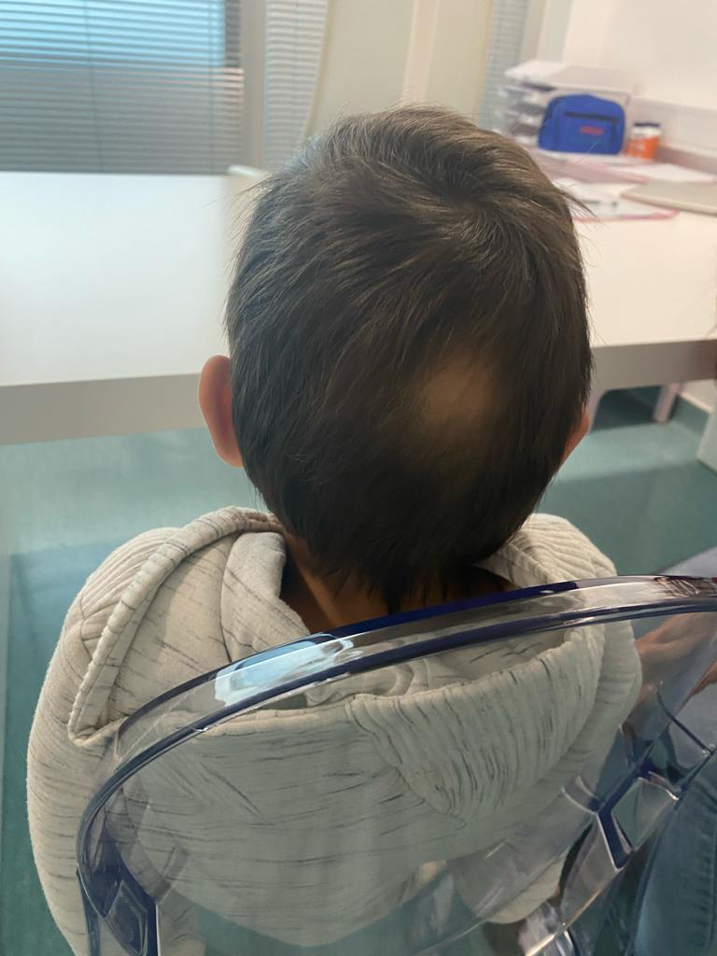
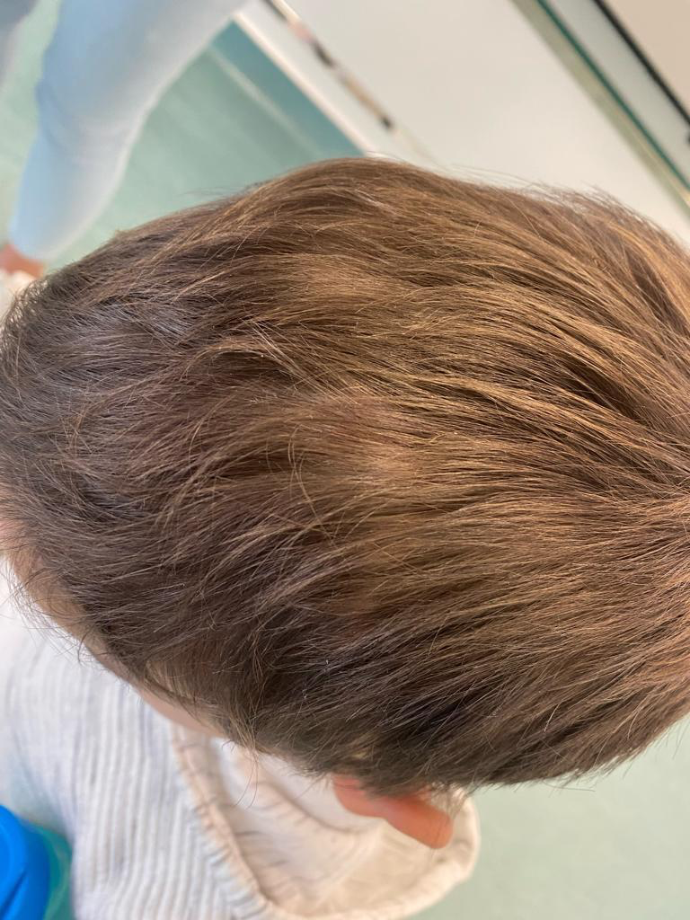
Progression After 5 Months of Conventional Treatment

Slide 30
REFERENCES
Almohanna, H.M., Ahmed, A.A., Tsatalis, J.P. et al. The Role of Vitamins and Minerals in Hair Loss: A Review. Dermatol Ther (Heidelb) 9, 51–70 (2019). https://doi.org/10.1007/s13555-018-0278-6
Alopecia in children: the most common causes, V Atton et al. Pediatr Rev. 1990 Jul. 12(1):25-30. doi: 10.1542/pir.12-1-25.
Castelo-Soccio L. Diagnosis and management of alopecia in children. Pediatr Clin North Am. 2014 Apr;61(2):427-42. doi: 10.1016/j.pcl.2013.12.002. Epub 2014 Jan 21. PMID: 24636654.
Darwin E, Hirt PA, Fertig R, Doliner B, Delcanto G, Jimenez JJ. Alopecia Areata: Review of Epidemiology, Clinical Features, Pathogenesis, and New Treatment Options. Int J Trichology. 2018 Mar-Apr;10(2):51-60. doi: 10.4103/ijt.ijt_99_17. PMID: 29769777; PMCID: PMC5939003.
Diagnosis and management of alopecia in children. Leslie Castelo-Soccio. Pediatr Clin North Am. 2014 Apr;61(2):427-42
Goluch-Koniuszy, Z. S. (2016). Nutrition of women with hair loss problem during the period of menopause. Przeglad menopauzalny= Menopause review, 15(1), 56.
Guo, E. L., & Katta, R. (2017). Diet and hair loss: effects of nutrient deficiency and supplement use. Dermatology practical & conceptual, 7(1), 1.
Management of tinea capitis in childhood. July 2010Clinical, Cosmetic and Investigational Dermatology 3(default):89-98
Pediatric androgenic alopecia: A review. Jacob Griggs et al. J Am Acad Dermatol. 2021 Nov.
International Science Nutrition Society- CURARE CAUSAM- 2023
Notes:
https://www.karger.com/Article/Abstract/492035

Slide 31
Thank you for joining us today!
International Science Nutrition Society- CURARE CAUSAM- 2023

